Slide 1
Marvis Electronics
Worked by: Sidrit Rrustemi – Leader
Viola Zeneli – Member
Megi Almadhi – Member
Arsildo Veliu – Member

Slide 2

Member’s Work:
By 6th January, all the classes needed for the model were finished by Viola, Arsildo and Megi.
(Employee Class, Administrator Class, Supplier Class, Sector Enumeration, Cashier Class, Bill Class, ClientCard Class, Manager Class, Item Class, Inventory Class)
By 10th January, all the codes were joined in 1 java project and we continued as a group to implement Main class.
By 20th January, Sidrit finished implementing JavaFX (based on the Main class).
The last 2 days before submission were devoted to test the program for any possible errors, bugs, flaws, etc. We corrected them and then prepared the UML Diagram and PowerPoint Presentation for our final submission.

Slide 3
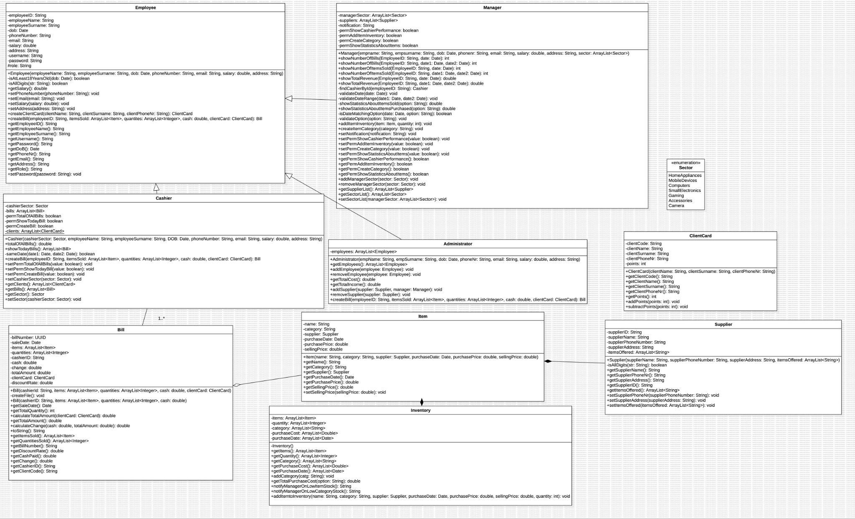
Model UML:

Slide 4
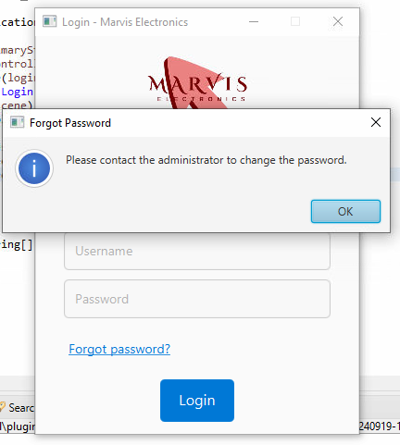
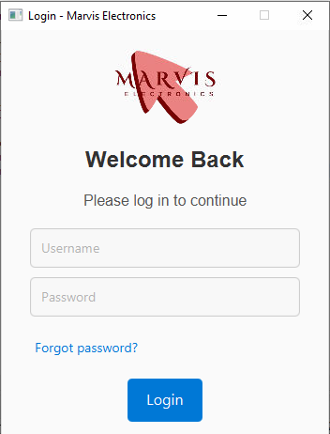
Login:
The login page in the Java project securely authenticates users by validating their credentials against a database to grant personalized access.
Custom Store Logo.
Enter the username specific to the employee.
Interacting with the forgot password button with give you an alert saying: “Please contact the administrator to change the password.”.
Enter the password specific to the employee.

Slide 5
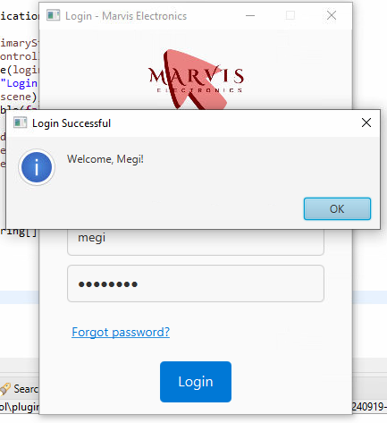
Cashier:
The cashier system processes transactions and ensures accurate billing for checkout.
After entering the correct information an alert will pop up displaying a welcome message next to the name of the employee logging in

Slide 6
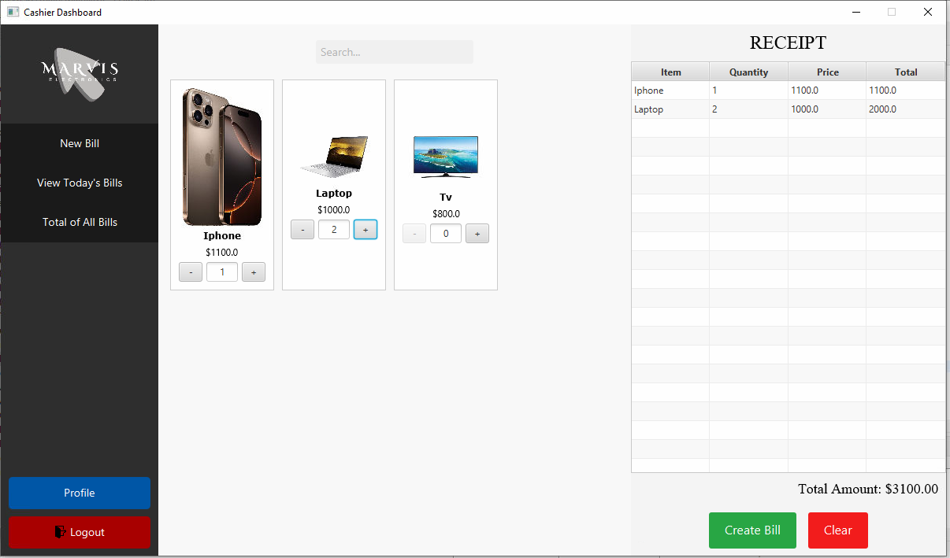
The Cashier is capable of creating a new bill, viewing all the bills he created today and see the total of all bills.
The bill/receipt will be displayed on the far right side of the screen where it is able to show the items in it, quantity of the items, price of a singular item and the total.
All products available to be sold will be displayed in the center of the screen where you can add or remove products from the bill
The create bill button will send you to an alert message where you will fill out other information needed for the transaction.
If you are not satisfied with the bill created or wish to remove it you can just press clear and it will return the receipt to empty.

Slide 7
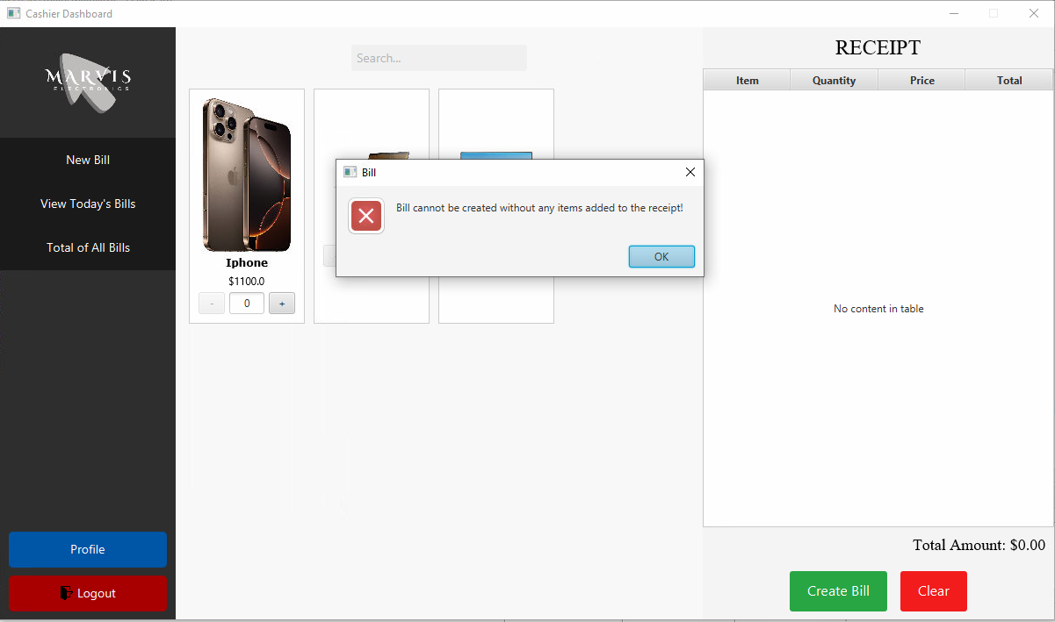
In the case that there are no items in the bill and you were to press the create bill button an alert will pop up saying “Bill cannot be created without any items added to the receipt!”.

Slide 8
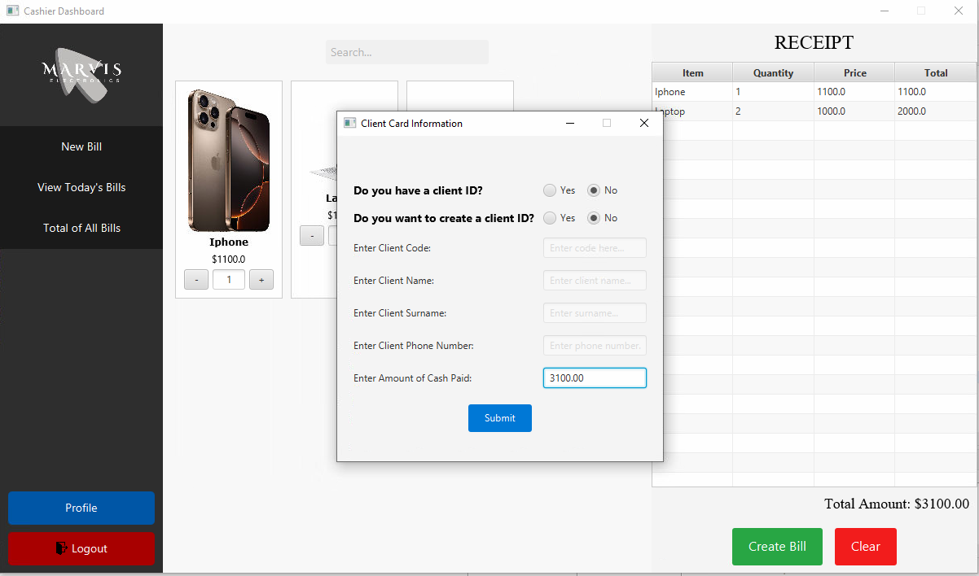
This case will show us as to how we can create a bill where the client doesn't have a client card and does not wish to create one.
The amount of cash paid must be equal to or more than the total amount otherwise you will get an alert message saying that the amount of cash paid is not enough.

Slide 9
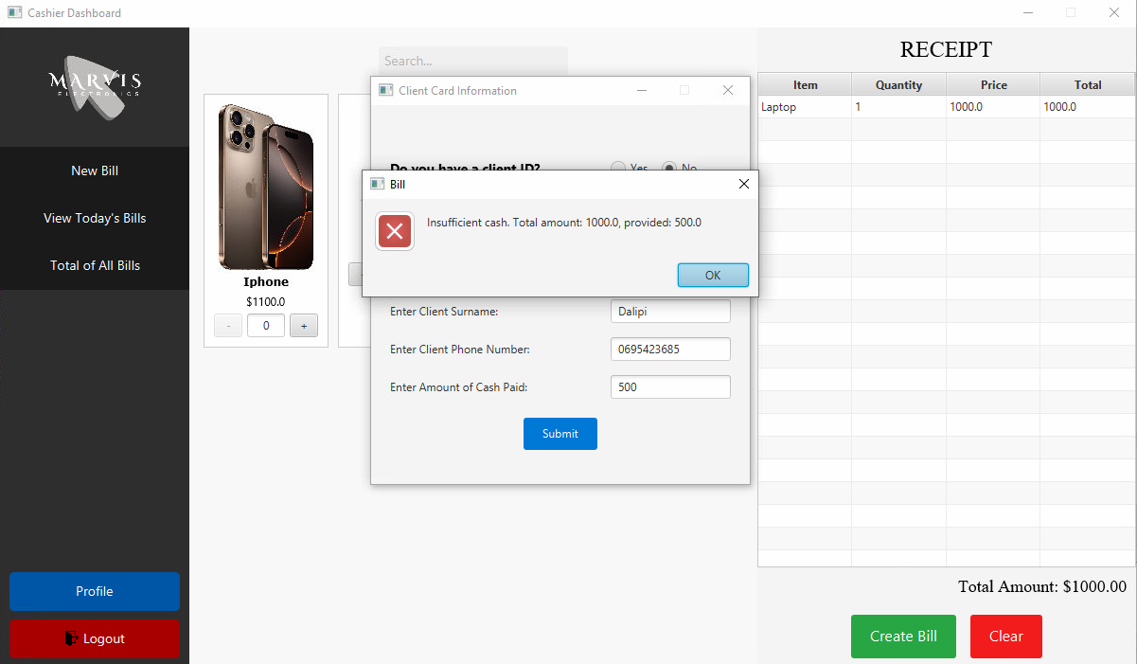
Alert message that pops up when you don't have enough funds to continue with the transaction.

Slide 10
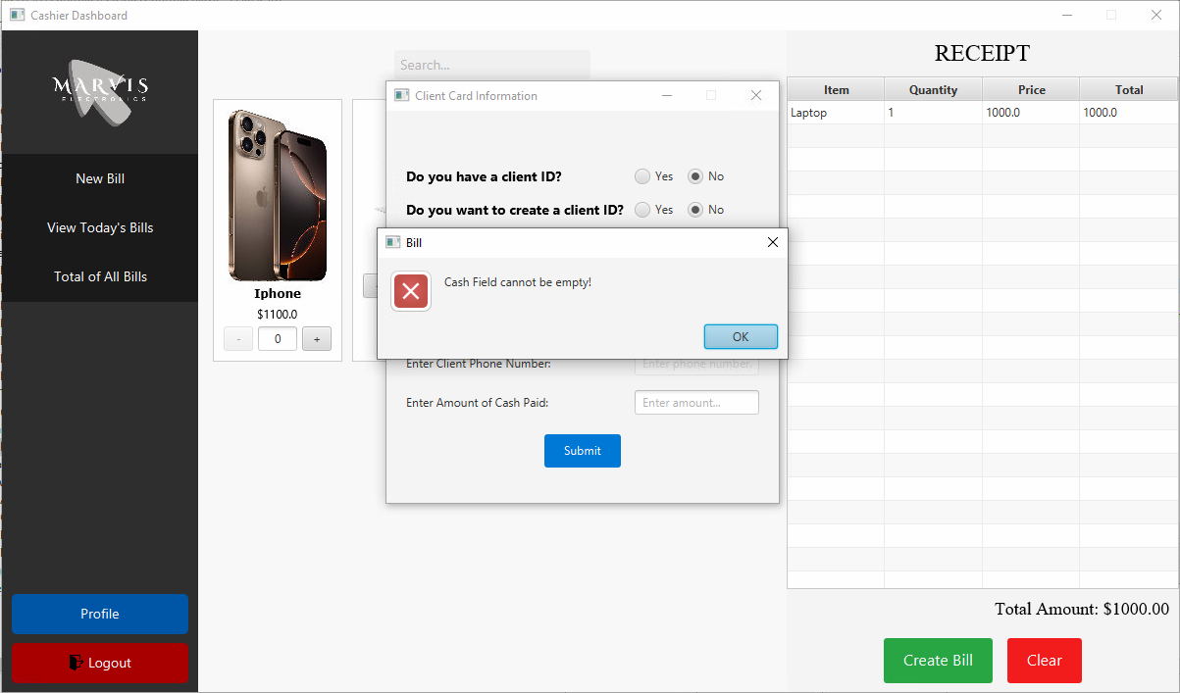
Alert message that pops up when you Have forgotten to enter the amount of cash paid by the costumer.

Slide 11
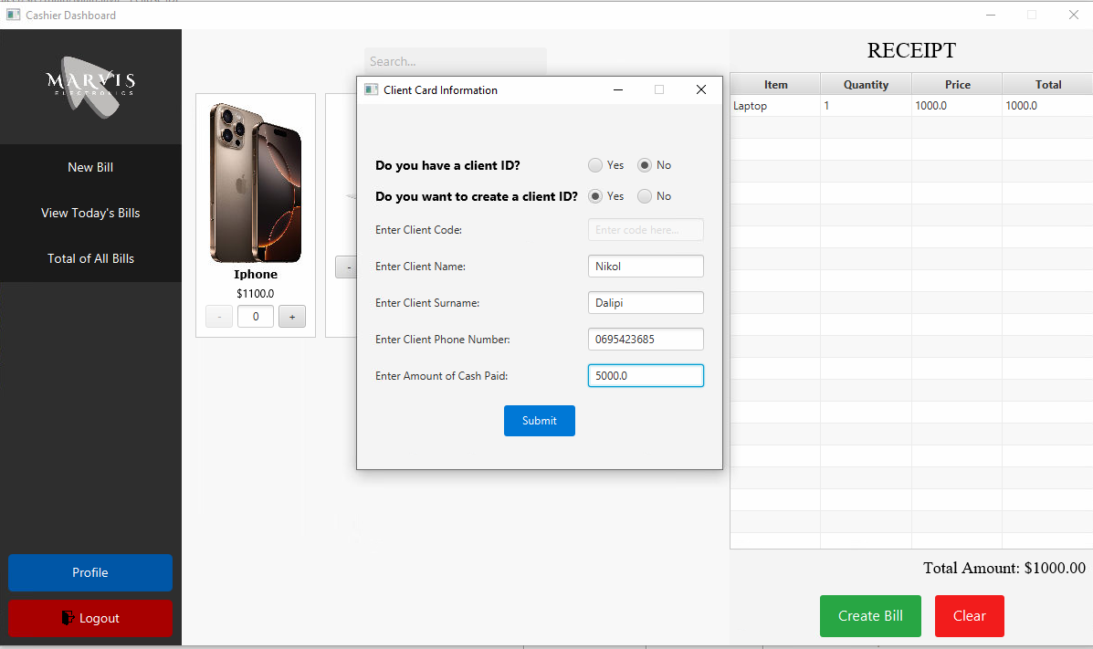
This case will show us as to how we can create a bill where the client doesn't have a client card but wishes to create one.
The cashier will need to enter the name of the client, the surname and phone number where later a unique client id is created and can be used in other instances.

Slide 12

If any of the information needed to create the client card is incorrect there will be alerts that will tell you what information is incorrect.

Slide 13

This case will show us as to how we can create a bill where the client has a client where in this case the cashier will need to enter the unique client ID.

Slide 14
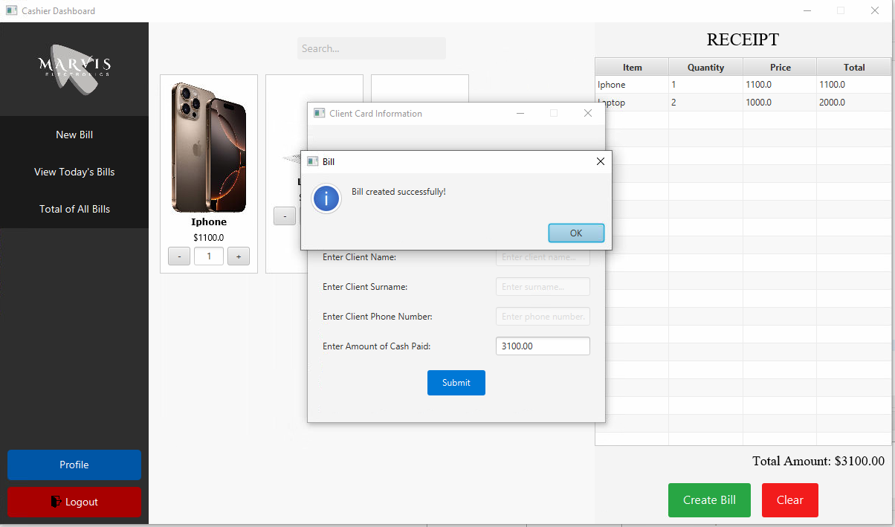
If all information is correct you will get an alert where it tells you that the Bill was created successfully.

Slide 15
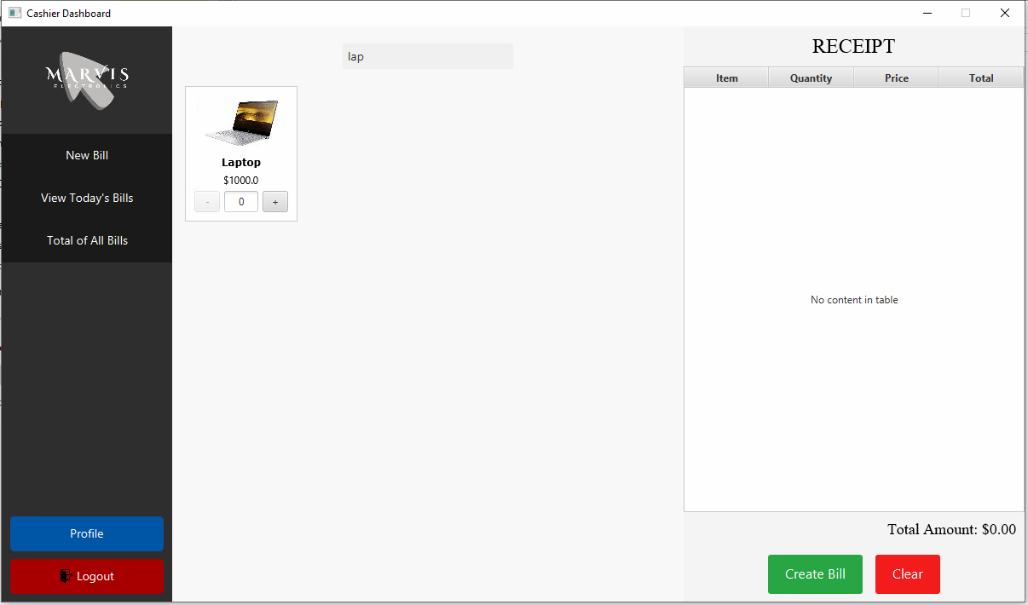
If there are too many products we can always use the search bar to find the required product easily.

Slide 16
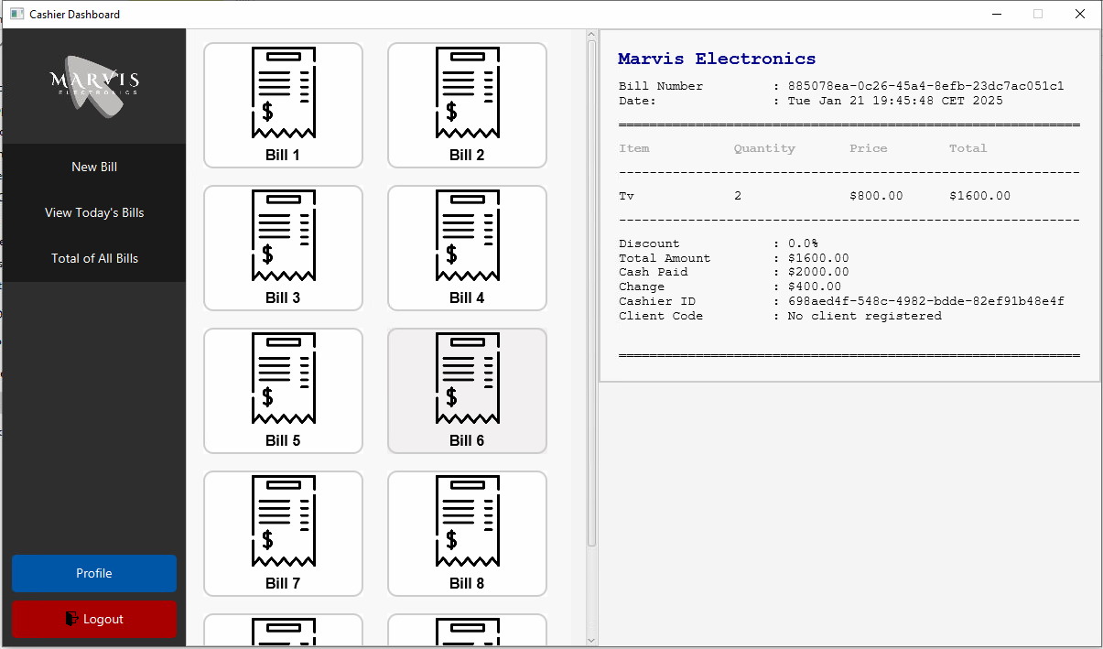
All bills created by the cashier will be displayed one by one.

Slide 17
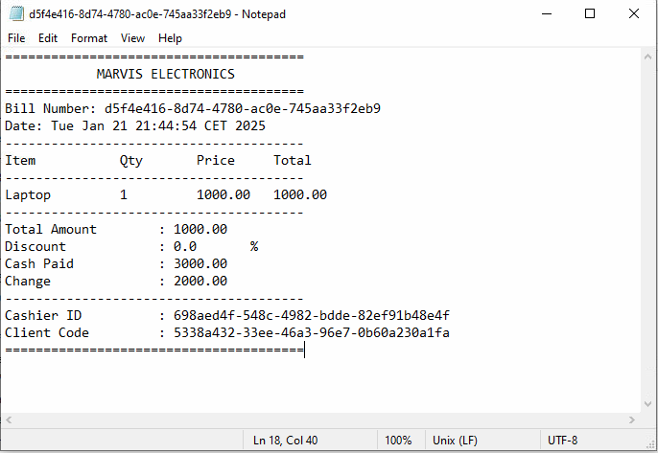
How the bill looks like inside the text file it is stored in all bills are unique and have their specific bill ID attached to it.

Slide 18
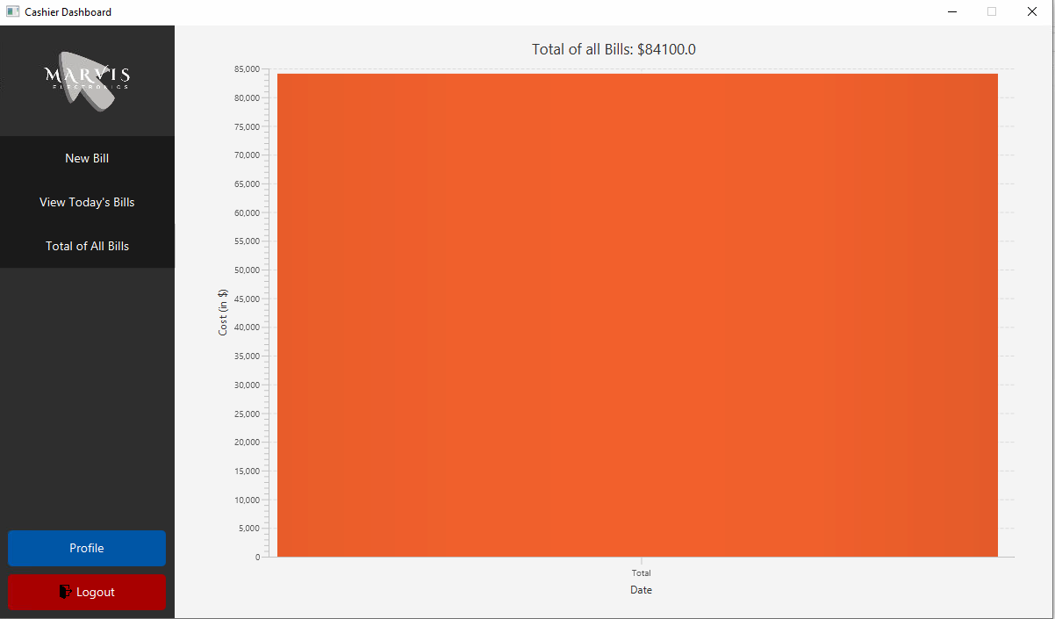
This is the char of the total of all bills created by the store.

Slide 19
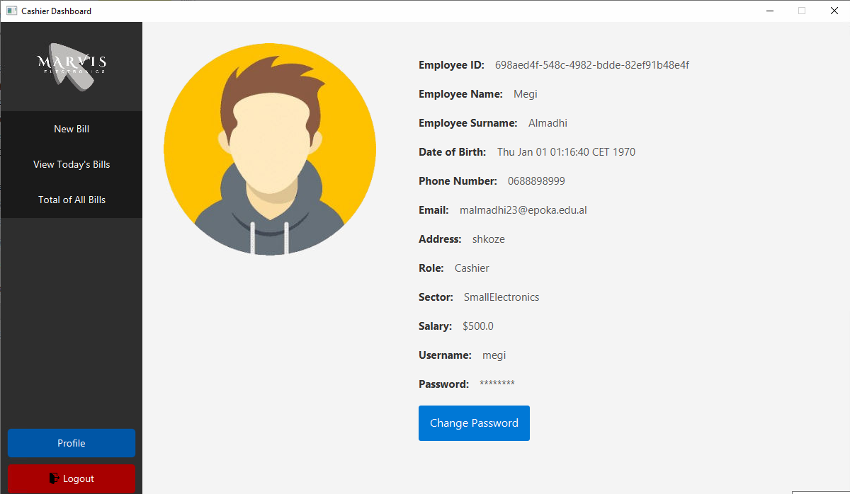
By clicking on the profile button it will send you to your unique profile where it shows all information about you.
Where's the logout button will log you out of the account and send you back to the login screen.

Slide 20
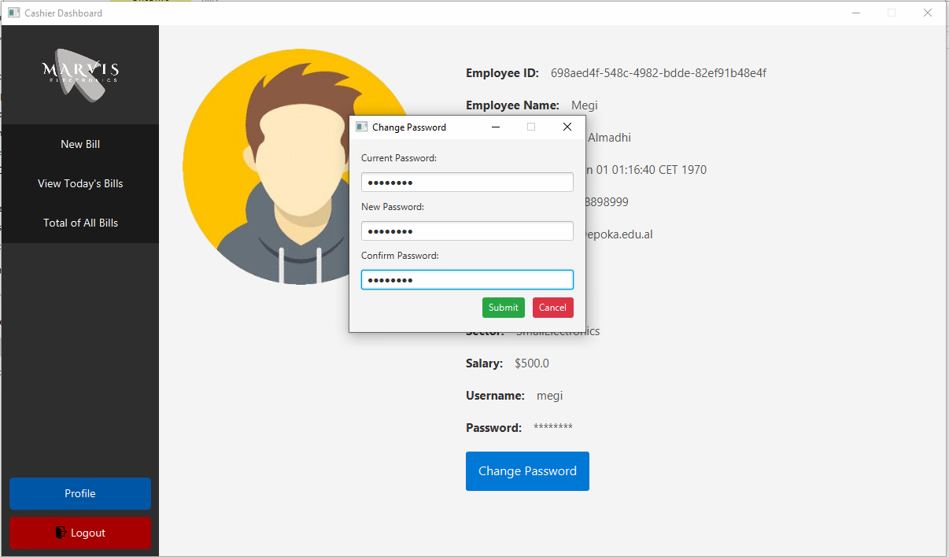
By clicking on the change password button you can create a new password for yourself however you do need the old password to change it.

Slide 21
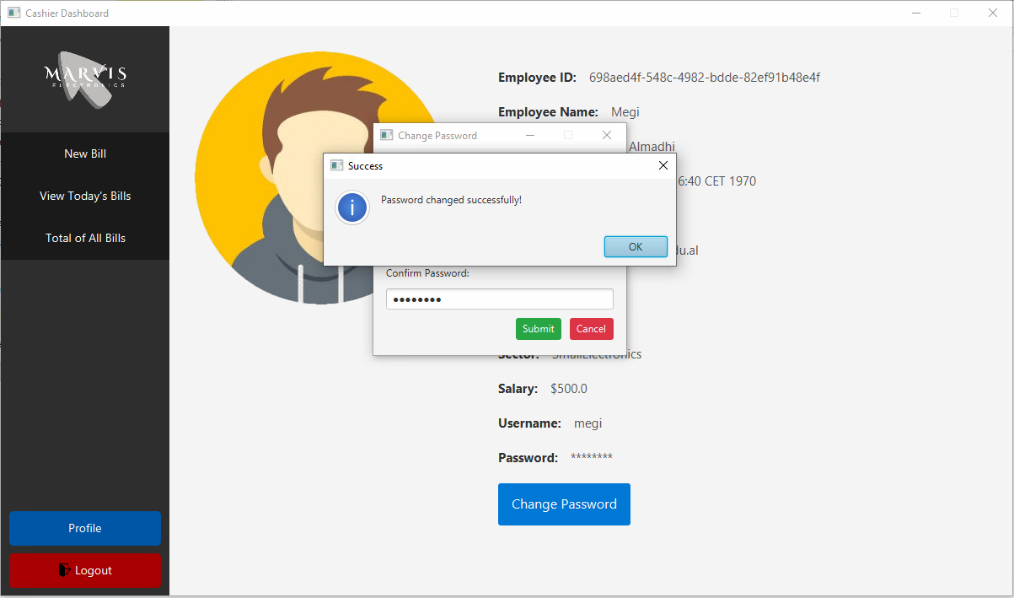
An alert will pop up telling you that the change was successful however if any information is wrong it wont allow you to change it.

Slide 22
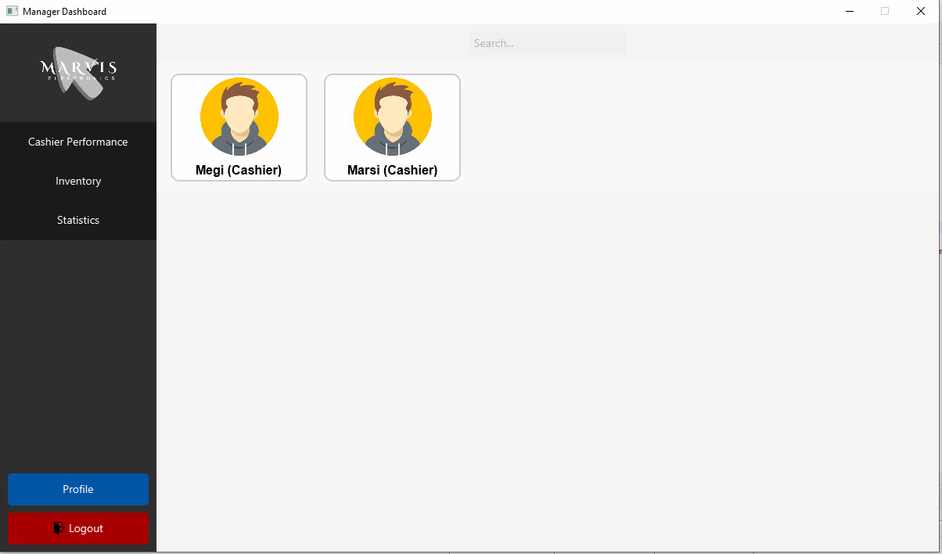
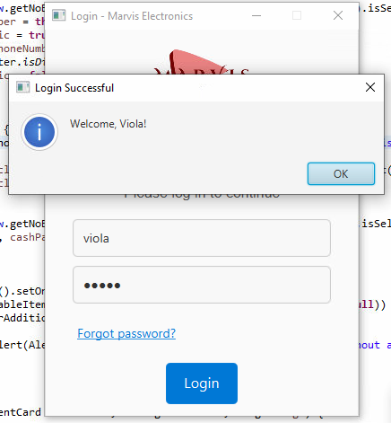
Manager:
The manager is capable of seeing cashier performance, the inventory of products and the statistics of the store.
All available cashiers will pop up in the center of the screen.

Slide 23
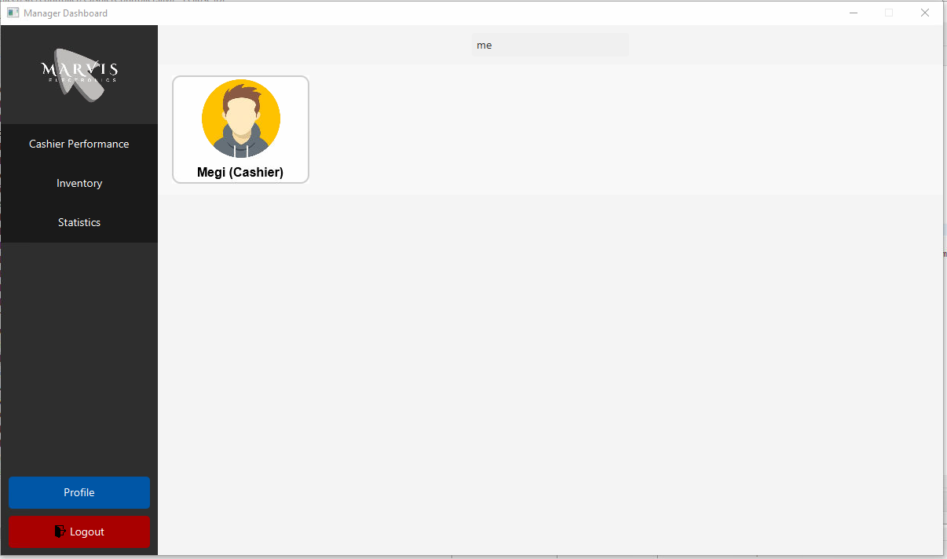
You can also use the search bar if the cashier you are looking for is too hard to find.

Slide 24
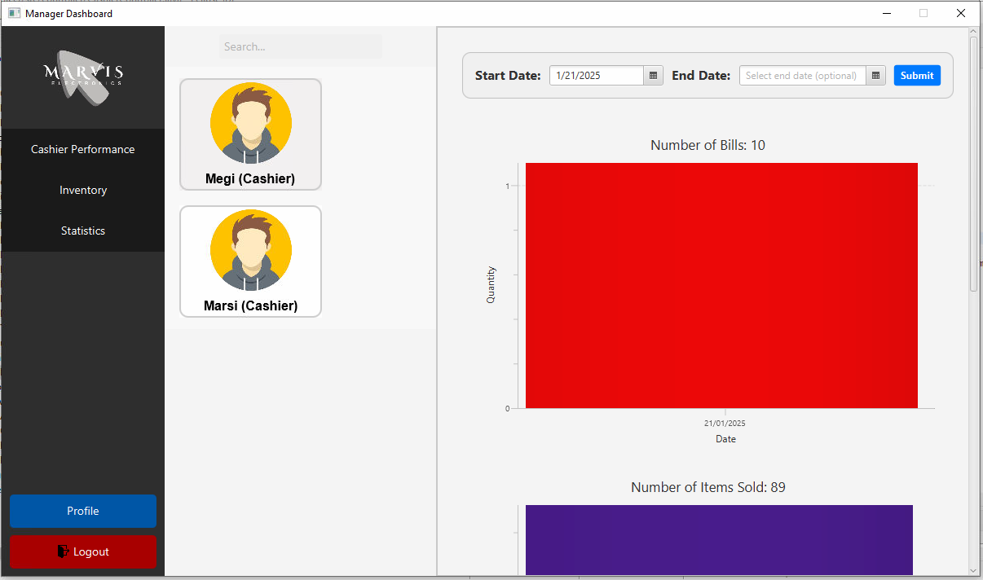
After clicking on a cashier you will be able to see the statistics of him for a set day.

Slide 25
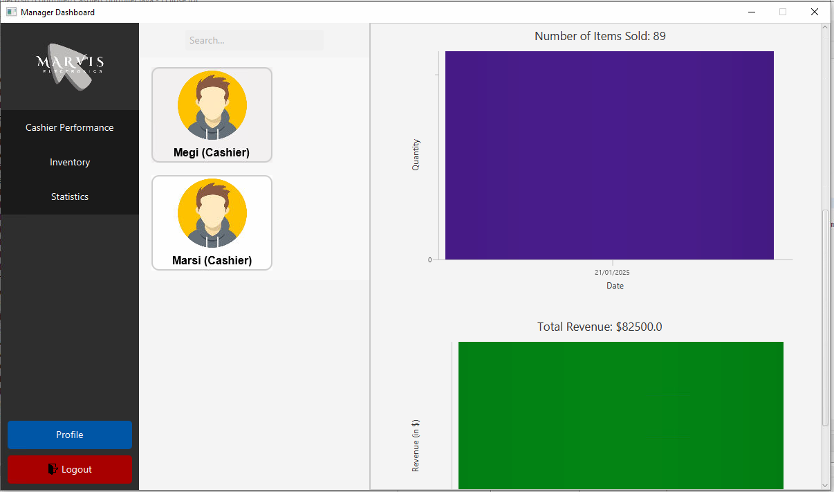
This information shows the number of bills sold, the number of items sold and the total revenue of that one cashier.

Slide 26
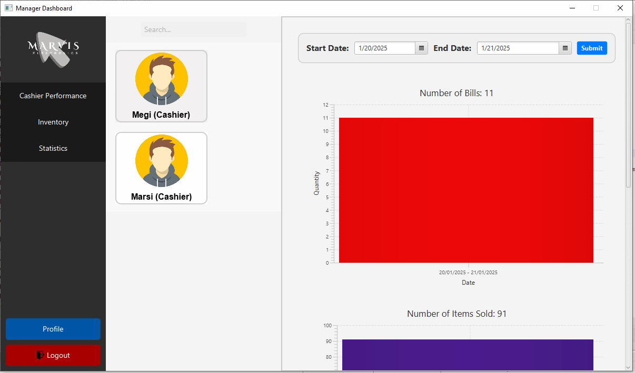
You can also see the performance of the cashier on a set time period(using 2 dates).

Slide 27
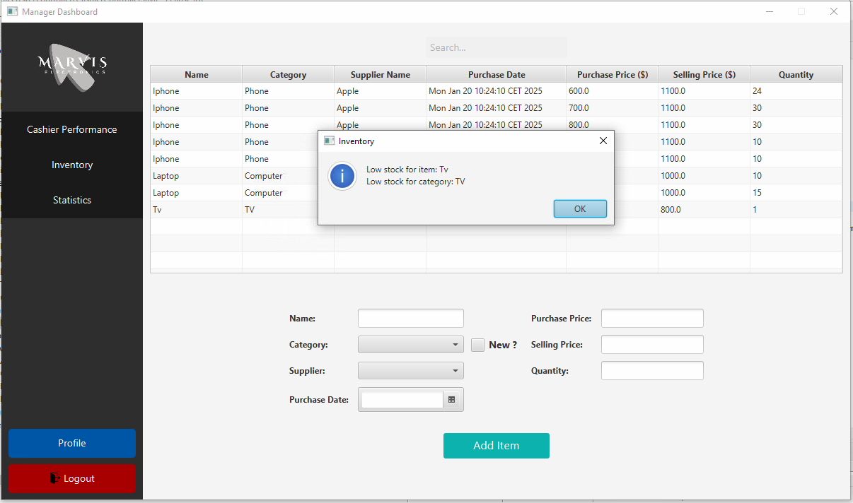
After entering the inventory screen you get an alert showing you all items low on stock.

Slide 28
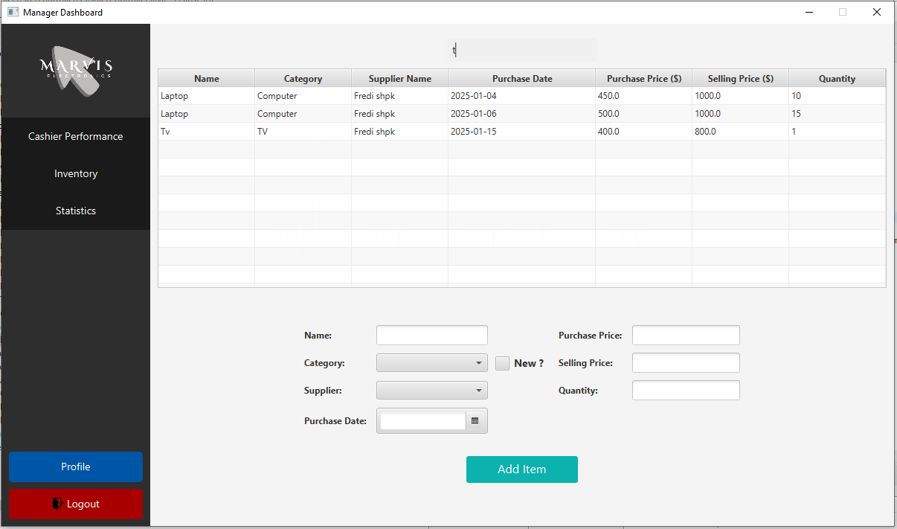
You can search for a specific item through the search bar if it is hard to find.

Slide 29
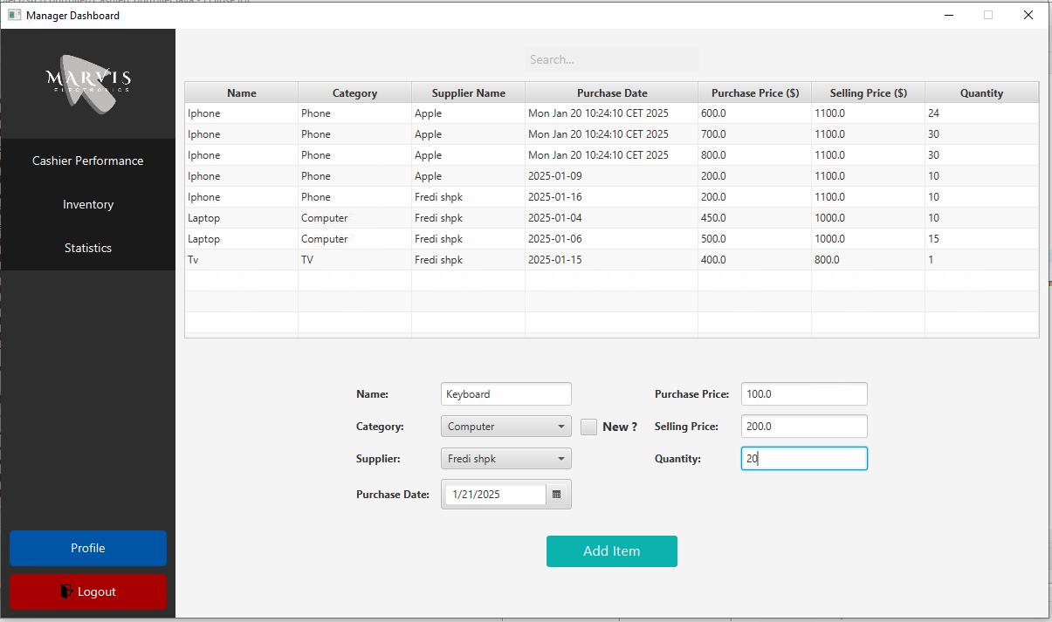
The manager can create a new product/item but he needs to fill in the name, the category, which supplier it has, the purchase date, the purchase price, selling price and quantity,

Slide 30
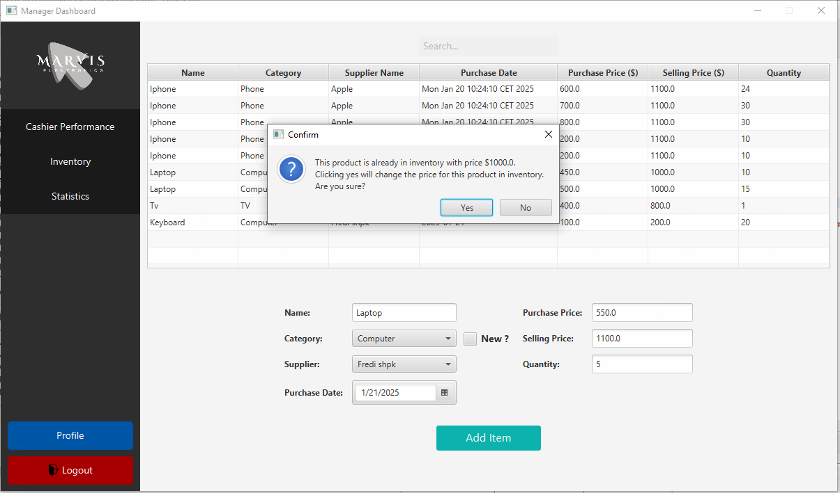
If you wish to change the price of an item you can change it by adding the name, category, etc of the intended product.

Slide 31
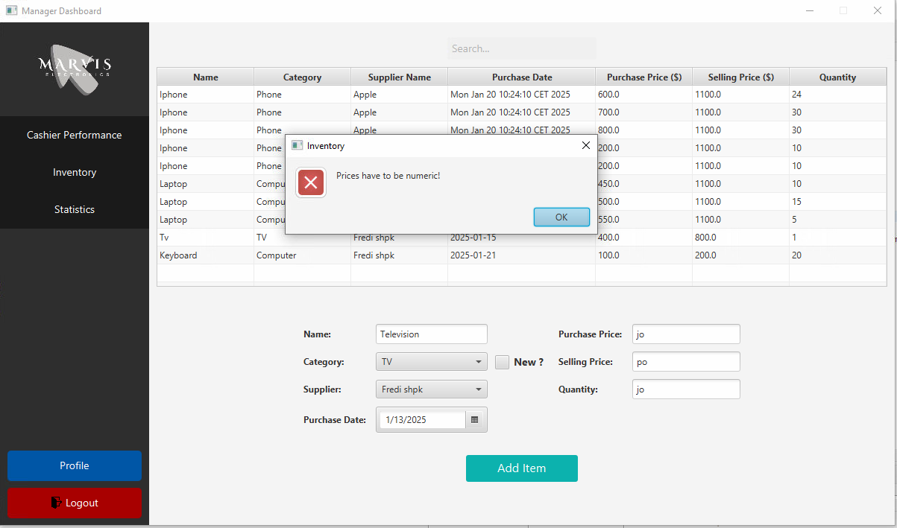
Any incorrect credentials will result in an anelt describing the incorrect field.

Slide 32

The menager can also create a new category if the new item doesn't fit into the previous categories.(all will be saved in their respected files.

Slide 33
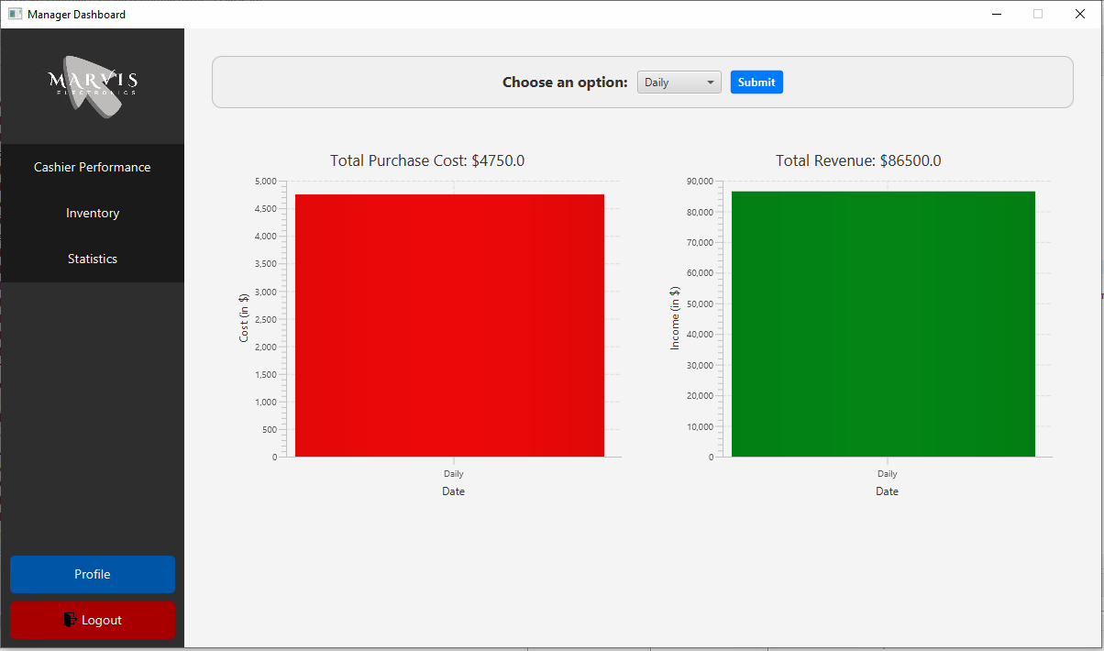
This case is for daily information
The statistics page will show the revenue and all the purchase cost of all the items.

Slide 34
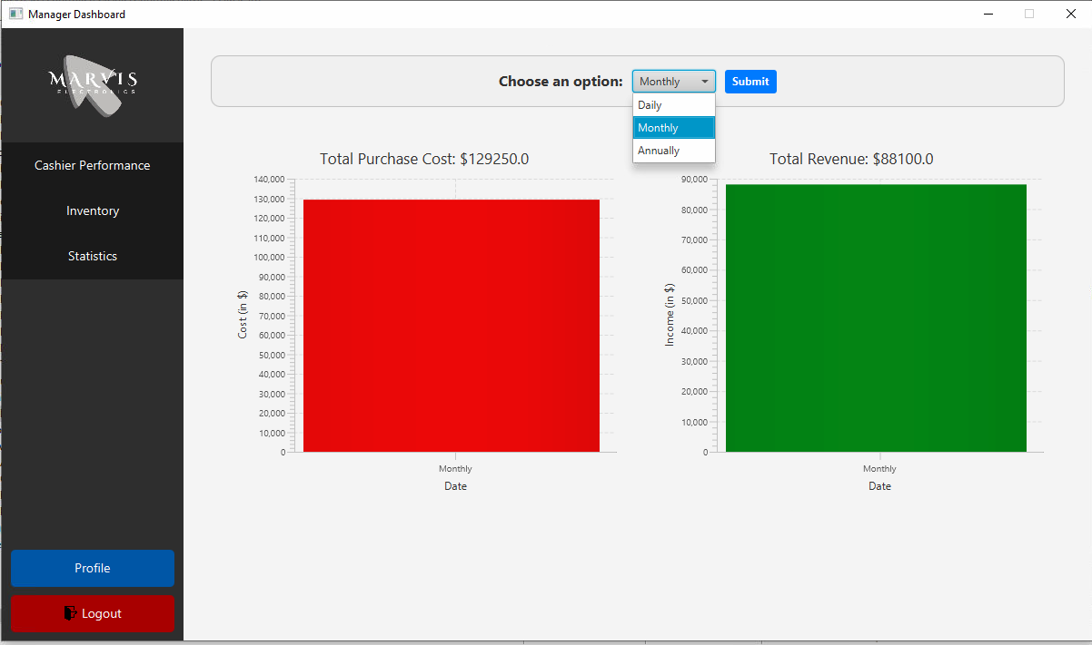
We can also see this information for monthly and annually cases.

Slide 35

The manager shares the profile button just like with the cashiers but as you can see all the information is unique.

Slide 36
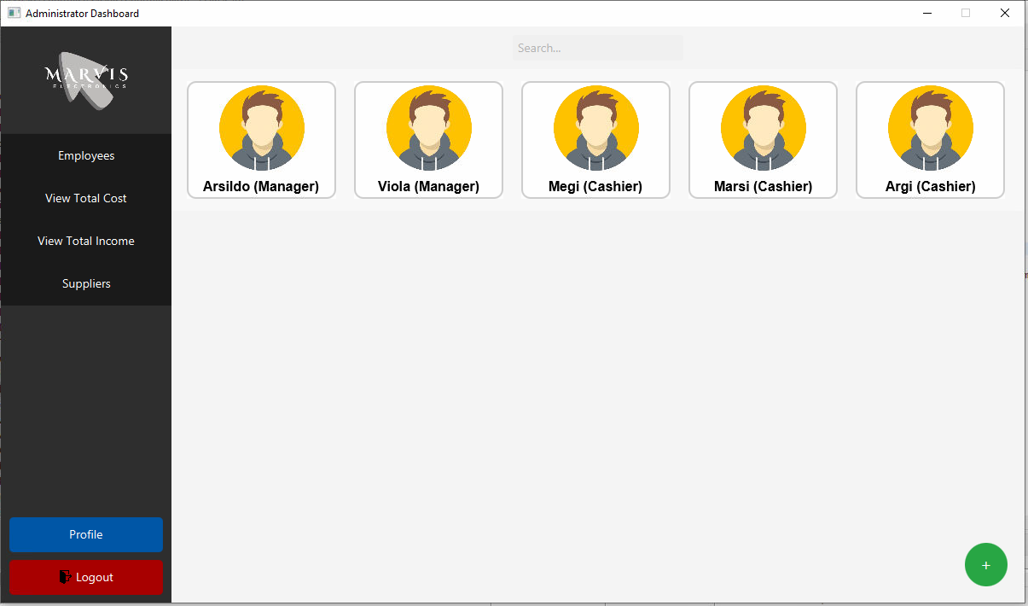
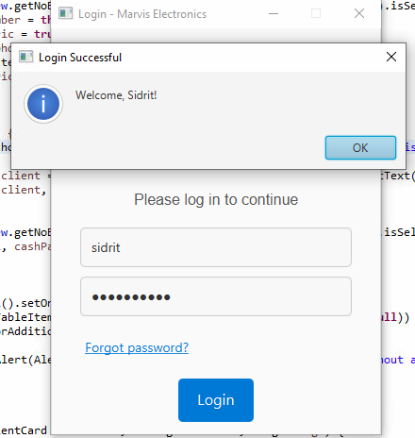
Administrator:
The administrator is capable of viewing all employees except himself.
He is able to view employees, view total cost, view total income, and work with suppliers.

Slide 37
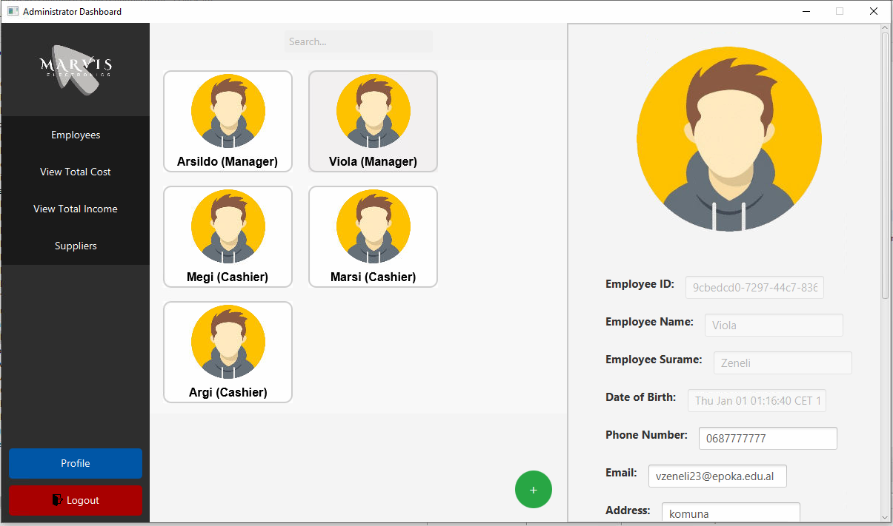
The selected employee will show up in the right side of the page and you will be able to view or edit information about him/her.

Slide 38
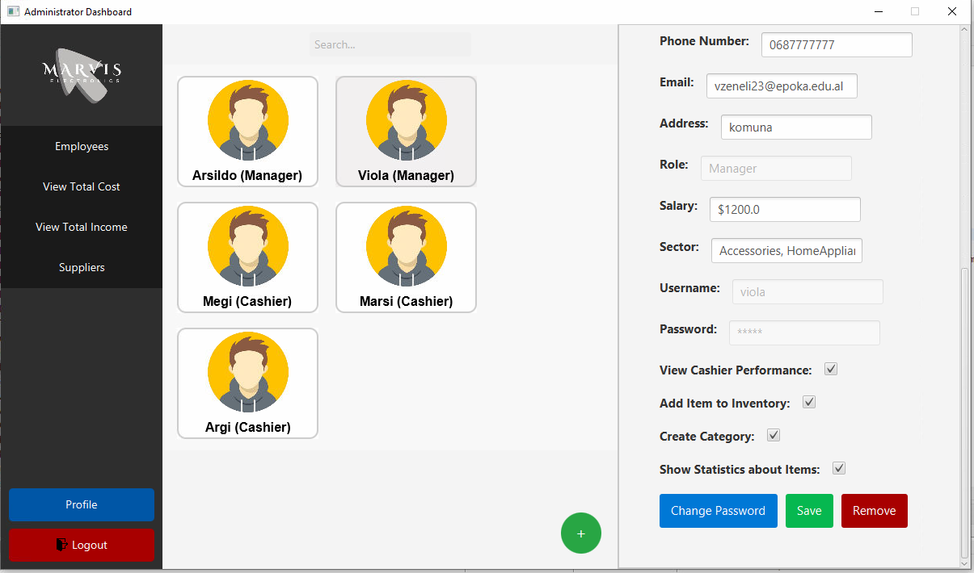
The administrator list of abilities consist of being able to create and remove employees change the phone number, email, address, salary, sector, he can give the employees permissions like viewing cashier performance, adding items to the inventory, creating categories, showing statistics, etc.

Slide 39
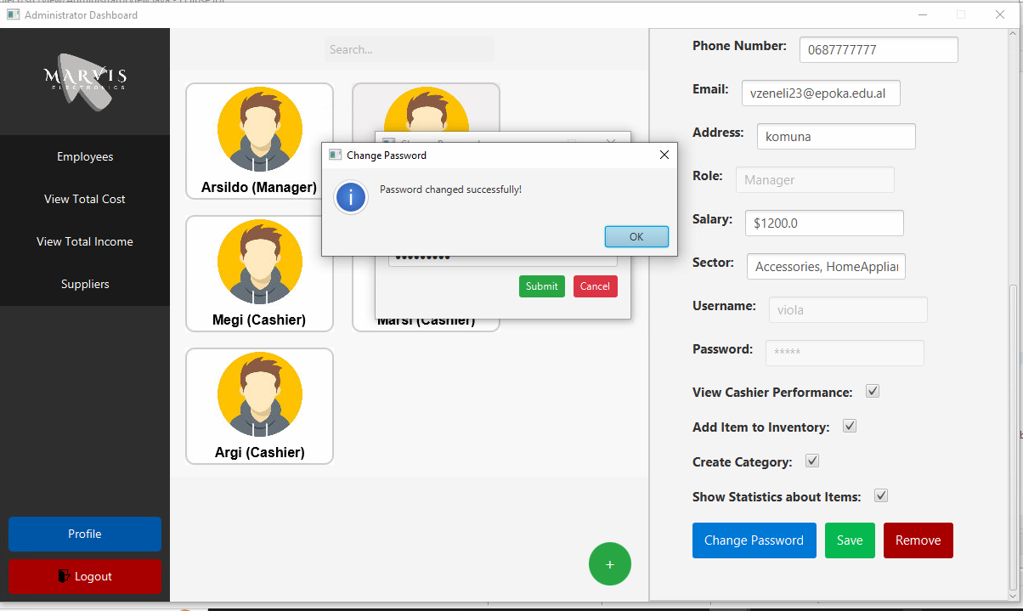
To change the password of an employee the administrator will need to enter the new password twice and an alert will pop up if it was successful.

Slide 40
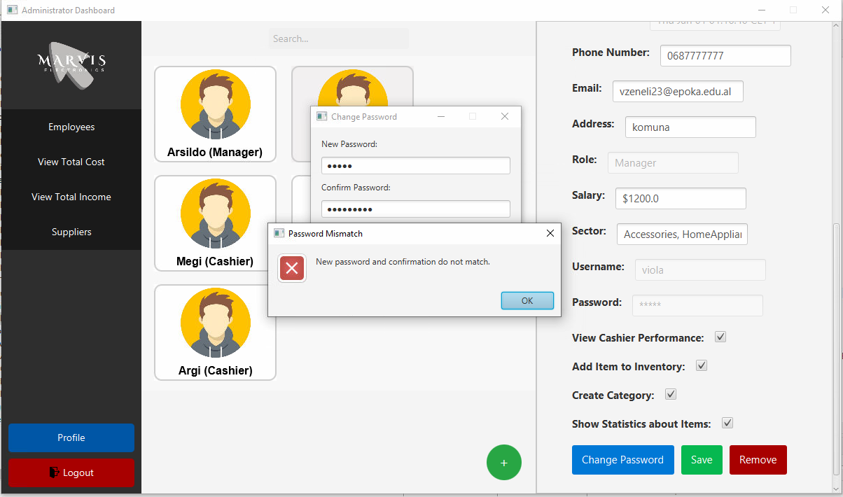
If the new password doesn't match an alert will pop up saying”New password and confirmation do not match.”.

Slide 41
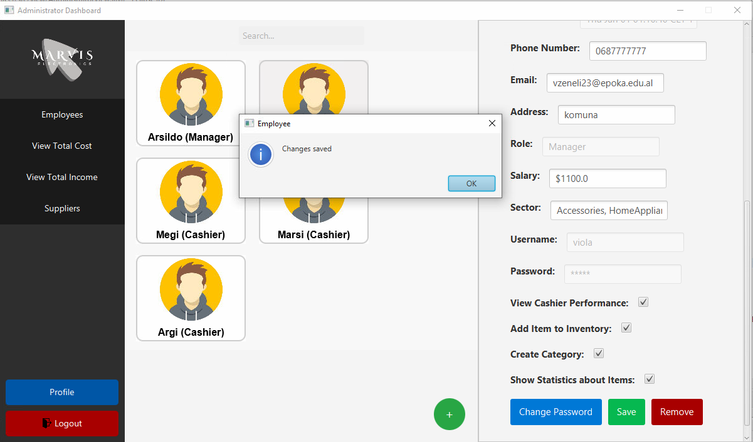
If all the new information is correct and the administrator presses on the save button an alert will pop up saying changes saved.

Slide 42
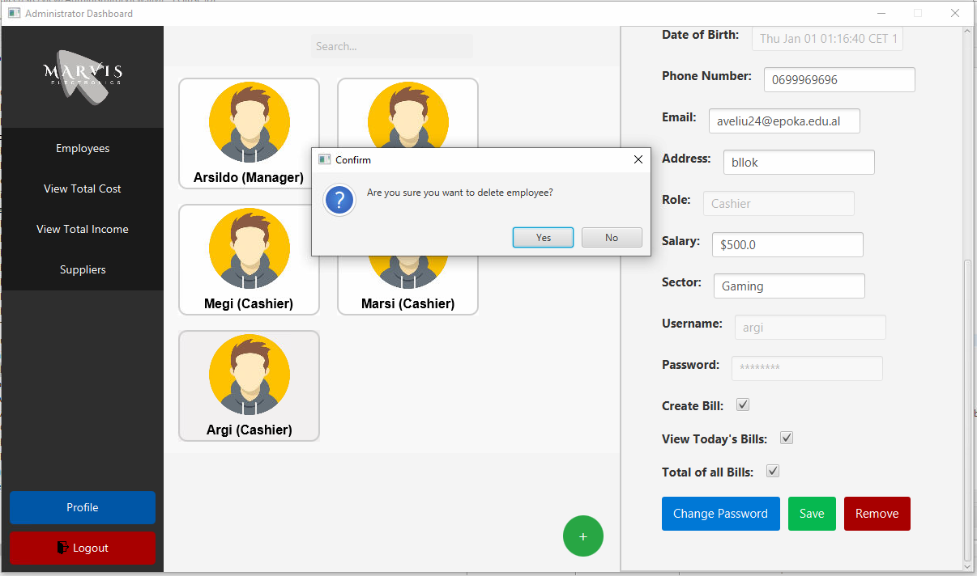
The remove button on the other hand will remove the selected employee and an alert will inform you that the employee is deleted.

Slide 43
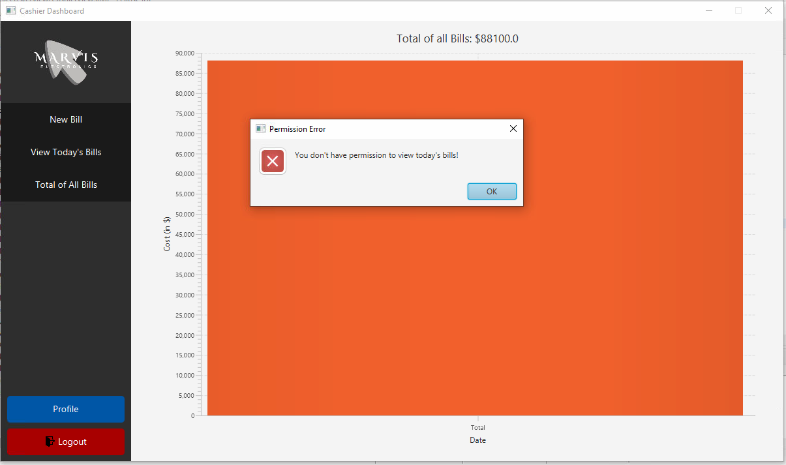
This is a case where we removed the cashiers ability to view today's bills and so an alert popped up when the cashier tried to view his bills.

Slide 44
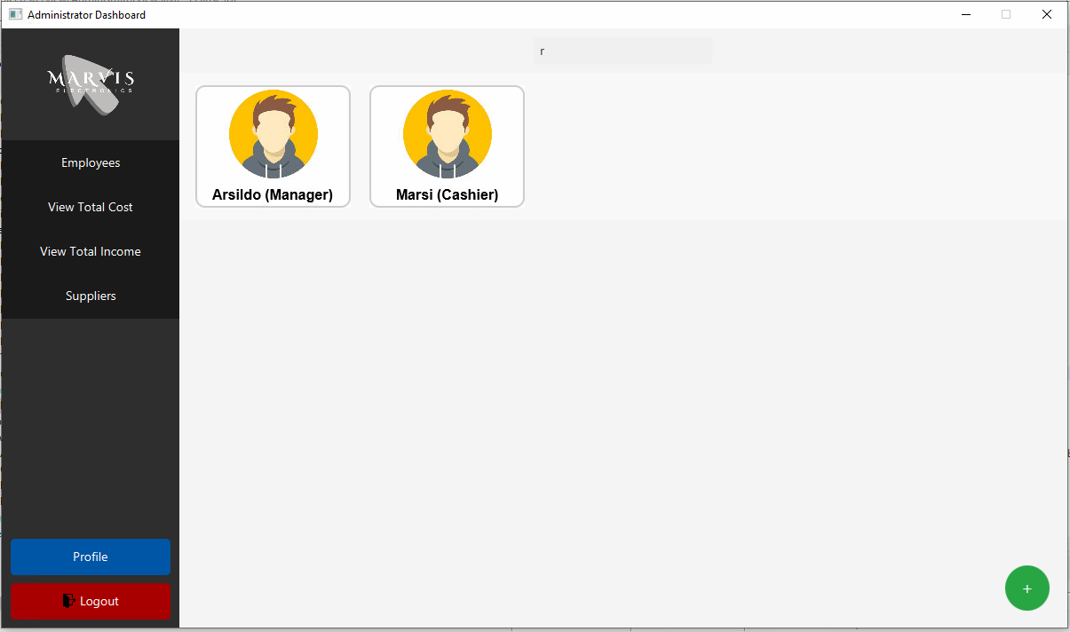
If you are looking for an employee but don't seem to find him you can always search for him through the search bar.

Slide 45
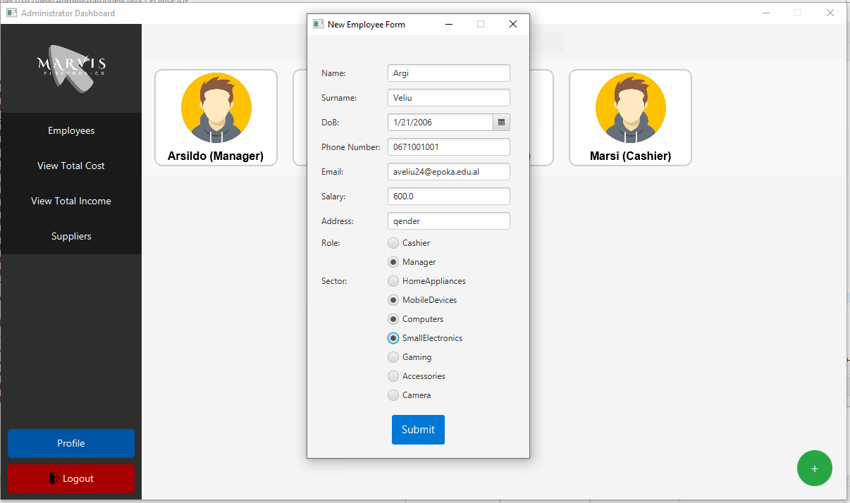
The plus button on the bottom right of the screen will allow you to add in a new employee by filling out all the necessary information.

Slide 46
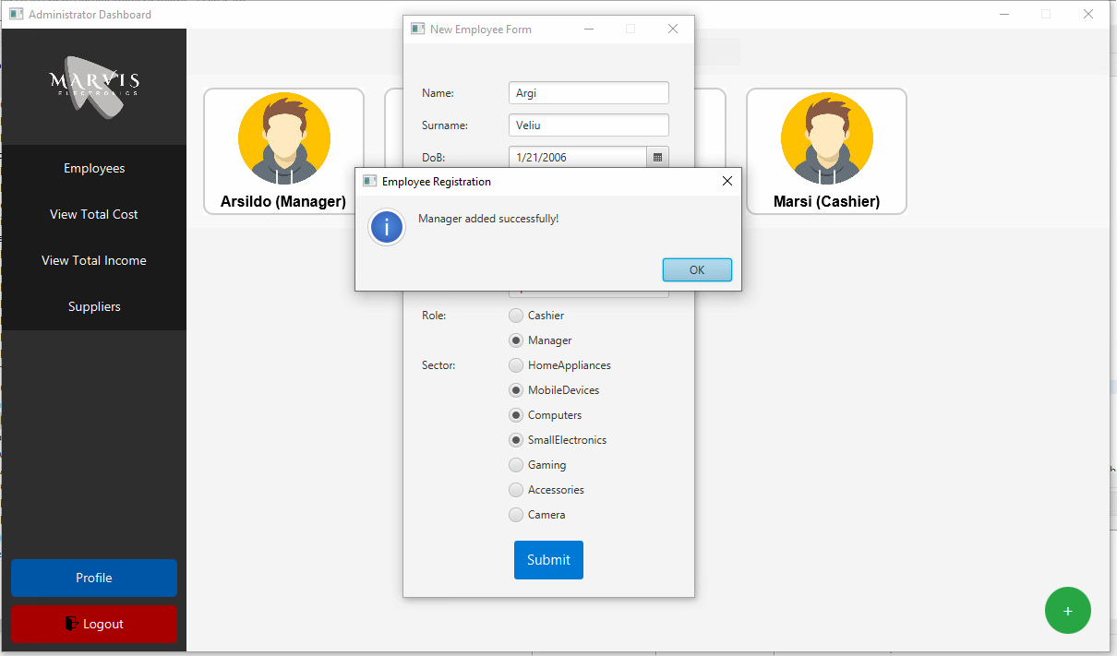
If all necessary information is correct an alert will pop up saying “Employee added successfully!”.

Slide 47
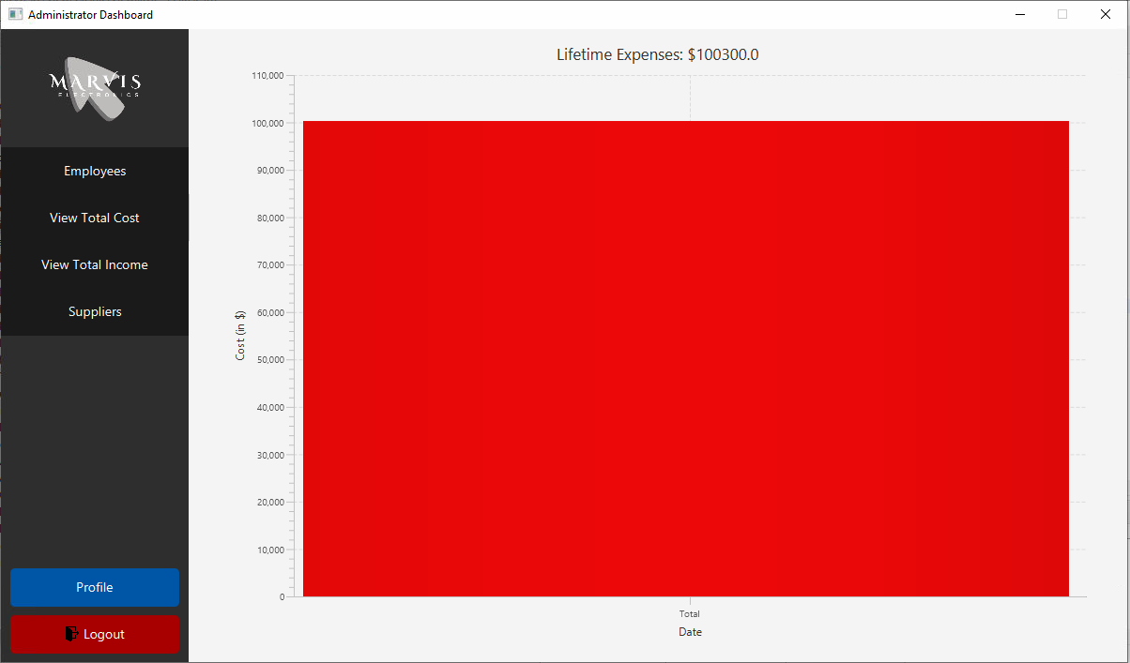
The view total cost page will show you the lifetime expenses of the store.

Slide 48
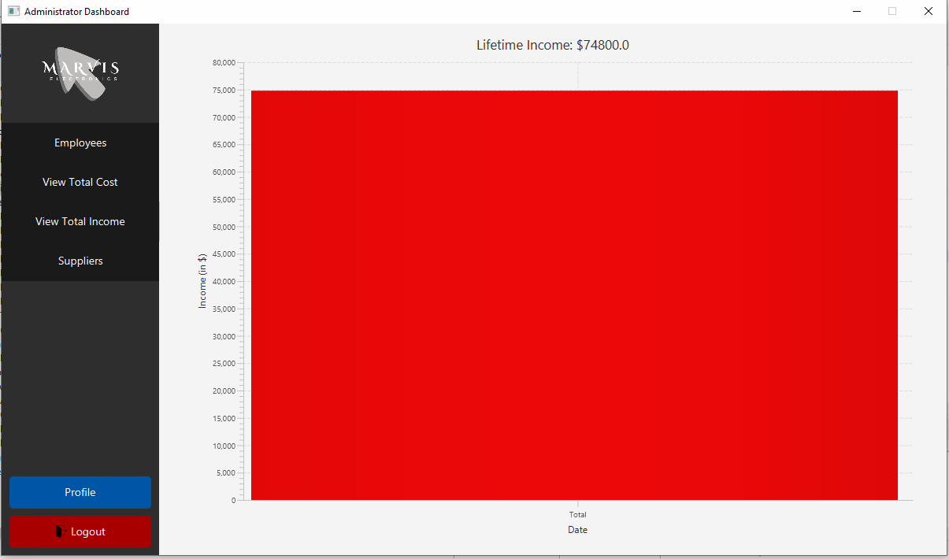
The view total income page will show you the lifetime income of the store.

Slide 49

The supplier page will show you all available supplier and allow you to edit them.

Slide 50
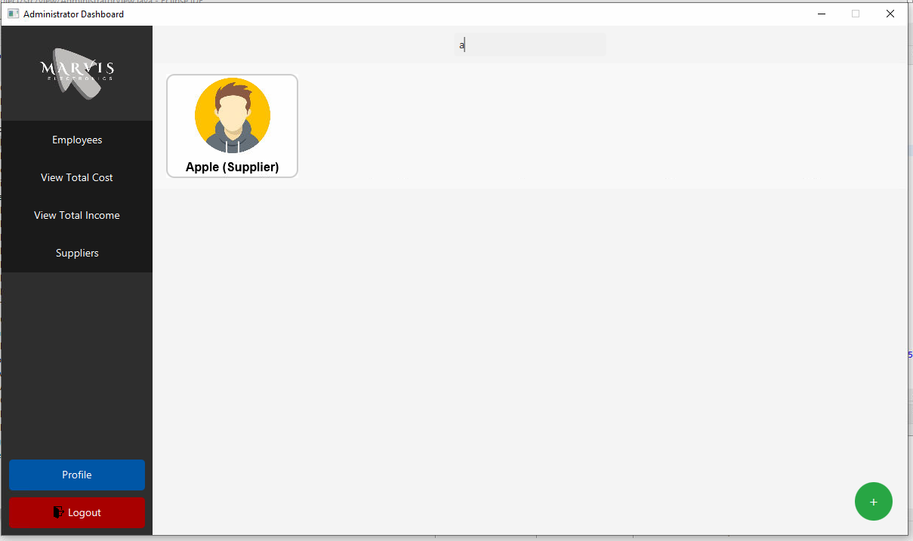
If you are looking for a specific supplier you can always use the search bar to find him/her.

Slide 51
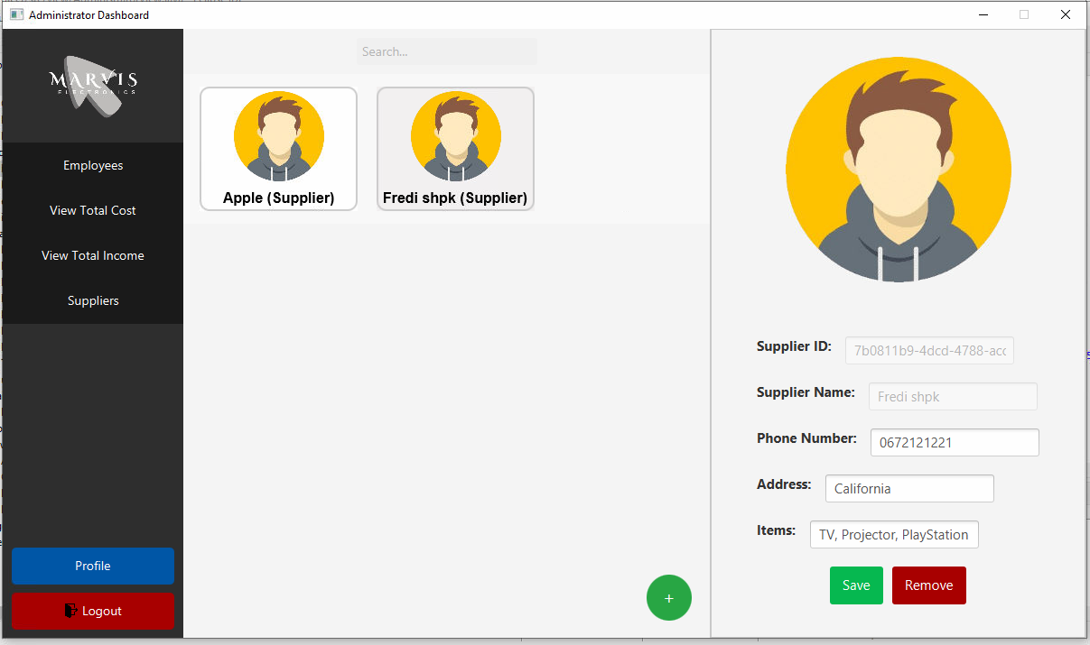
By clicking on a supplier you are able to view his information and change it you can also remove him/her.

Slide 52
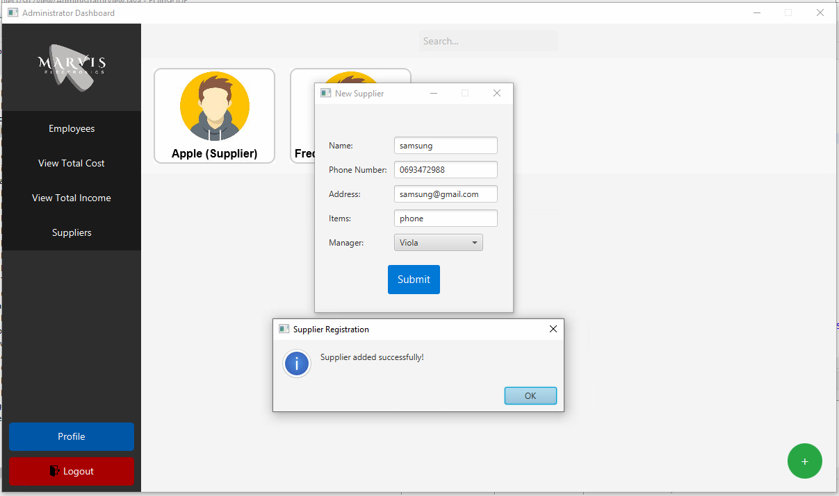
You can also add a new supplier by pressing the plus button on the bottom right side of the screen however you will need to enter the information about that supplier and if everything is correct an alert will pop up saying “Supplier added successfully!”.

Slide 53

Thank you for your attention!
We hope to see you shopping at out store soon!

